Slide 1
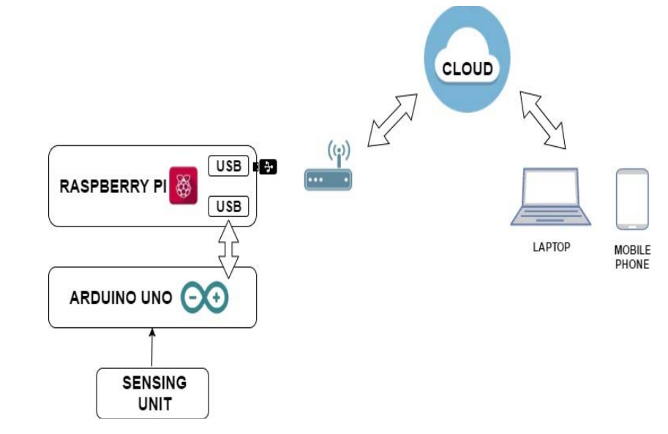
Air Quality Monitoring System Based on IoT using Raspberry Pi
(ICCCA 2017)
Significance of Air Quality Monitoring: Acknowledges air pollution as a major global challenge affecting human health, climate, and ecosystems.
Parameters Monitored: PM 2.5, carbon monoxide, carbon dioxide, temperature, humidity, and air pressure.
Sensors Used:
* DSM501A, * MQ9 and MQ135, *DHT22, * BMP180
Softwares:
* Raspberry Pi, * Node-Red, * Integrated Development Environment, * MQTT Protocol
Cloud Integration:
IBM Bluemix

Slide 2
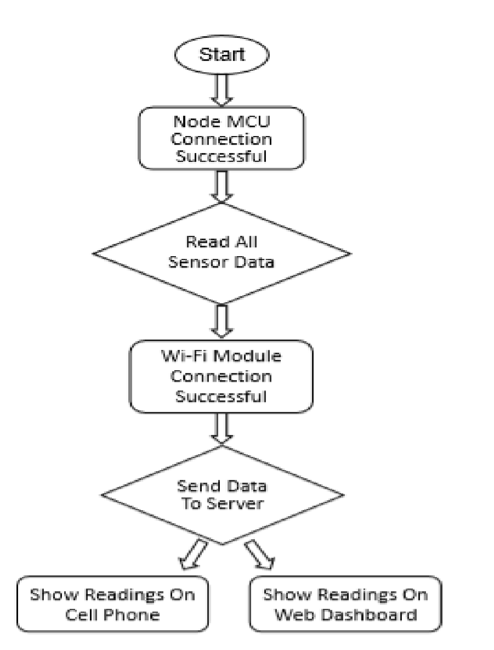
Iot Based Air Pollution Monitoring System (IJSRET - 2023)
Objective:
Monitoring industrial pollution and air quality levels in areas with high traffic
Technologies Used:
a. Sensor Array
MQ135 for measuring CO2, SO2, CH4, NH3.
MQ 9 for measuring CO and Propane (C3H8).
MQ2 for detecting gas leakage.
b. ESP32 Microcontroller
c. Blynk 2.0
Methodology:
The system uses a sensor array and an ESP32 microcontroller which reads sensor data, and through Wi-Fi connectivity, transmits it to the Blynk 2.0 Cloud. The Blynk platform enables real-time data visualization on mobile devices and a web dashboard. In case of gas leakage detected by the MQ2 sensor, the system sends notifications to mobile phones.

Slide 3
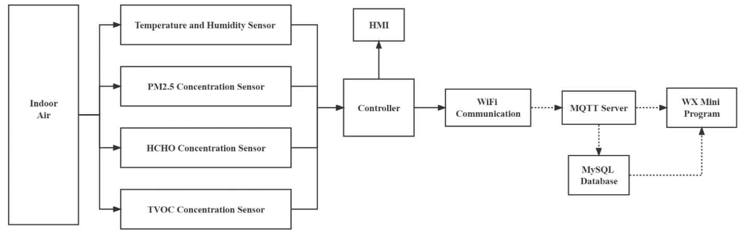
A Design of Indoor Air-Quality Monitoring System , J. Phys. - Conf. Ser.(2022)
Objective:
To realize the monitoring and evaluation of indoor air quality.
System design:
It uses sensors, MCU, WiFi, Elastic Compute Service (ECS), MQTT (Message Queuing Telemetry Transport), MySQL Database, WeChat Mini Program.
The figure represents the overall architecture. Data flows from sensors through the MCU, WiFi, ECS, MQTT, and into the MySQL database, with remote access facilitated by the WeChat Mini Program.
Sensors:
DHT11 Temperature and Humidity Sensor
FS00202 Laser Dust Sensor
FS00602 TVOC Sensor
FS00509 Formaldehyde Sensor

Slide 4
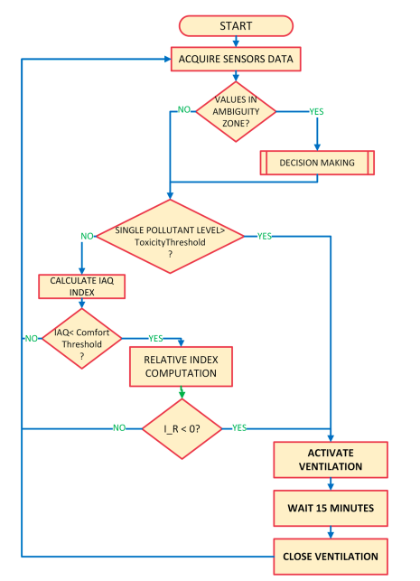
An Improvement Strategy for Indoor Air Quality Monitoring Systems
MDPI (2023)
Key points:
Significant influence of indoor environmental factors (temperature, humidity, ventilation, pollutants, etc.) on health
To use advanced IoT systems to monitor and improve indoor environment quality (IEQ) by analyzing pollutant concentrations and evaluating thermal, acoustic, and visual comfort.
Role of Temperature and Humidity
Relation Between Air Quality and Health
Algorithm for monitoring and control.
Key parameters monitored include CO2, VOCs, CO, and PM2.5

Slide 5
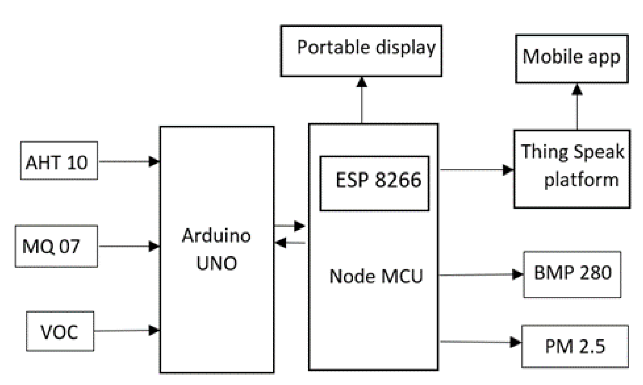
An IoT-based handheld environmental and air quality monitoring station
IMEKO (2023)
Objective:
To create a portable weather monitoring device that measures critical weather and air parameters used in daily life.
Key Parameters Measured:
Temperature, pressure, humidity, altitude, PM2.5, PM10 levels, VOC (volatile organic compounds), and CO (carbon monoxide) levels.
Components of the System:
Portable display and a mobile app integrated with a ThingSpeak cloud platform. Wi-Fi and GSM connectivity for data communication.
Advantages Over Existing Models:
The prototype is highly portable, easy to install without the need for trained technicians, and easy to maintain.
It provides worldwide data access via Wi-Fi connectivity and supports data visualization and analysis.

Slide 6
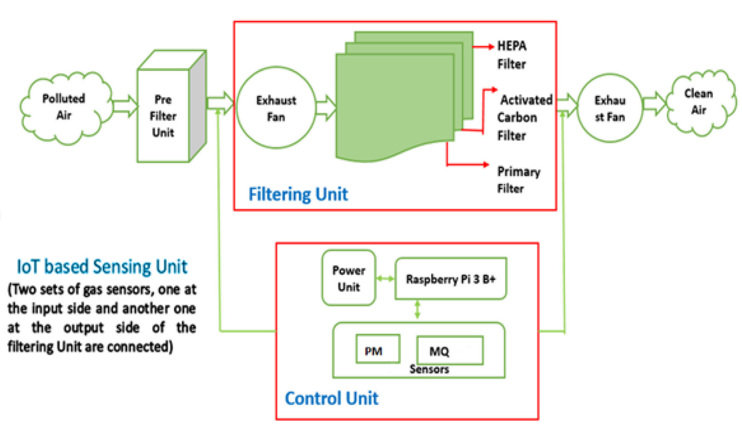
Development of an IoT-Enabled Air Pollution Monitoring and Air Purifier System
(MAPAN - Journal of Metrology Society of India (September 2023))
Objective:
To design a smart air pollution prototype capable of purifying the air.
Sensor and Filter Components:
MQ2 and MQ135 - to measure the presence and concentration of gases such as LPG, smoke, CO, CO2, and NH4.
PMSA003 - to detect Particulate Matter (PM) in the range of 0.3 microns to 10 microns.
Analog-to-digital converter (ADC) and Raspberry Pi 3 B+ - to convert the sensor outputs into particle concentrations.
Data Visualization:
Sensor data can be viewed on various systems and mobile devices through the ThingSpeak Cloud platform.

